Slide 1

AWS + PYTHON = <3
Seth Carpenter

Slide 2


WHAT IS AWS?
Androids Wearing Slacks
This Photo by Unknown Author is licensed under CC BY-SA

Slide 3
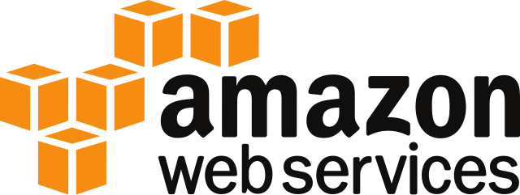
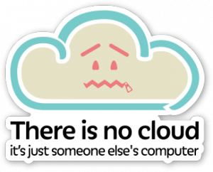
WHAT IS IT?
Cloud Computing Services Platform
RENT
Compute
Storage
Software Services
Amazon’s datacenters across the world
(currently 20 regions, 4 in the U.S.)

Slide 4



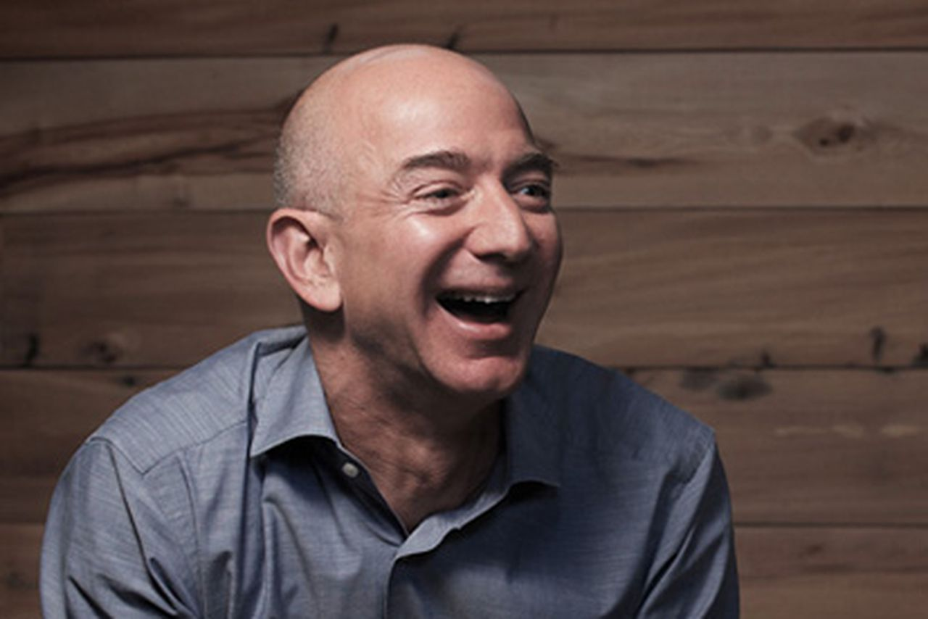
WHO’S USING THIS AWS CLOUD THING?
45% jump in revenue
(Q4 ’18)

Slide 5
WHY? Advantages of Cloud Computing
Instantly Scalable
No wait for servers to be delivered/racked/stacked/OS installed
Allows for bursts in computing needs
Pay-As-You-Go Pricing Models
Tear down after proto-typing
High traffic times of year
Watch out, easy to overspend!
Infrastructure as Code
Spin up compute and storage infrastructure through code
Repeatable, reduces human error
Easier Management
Amazon manages failing hardware
Quick deployment of infrastructure through a GUI

Slide 6
WHY NOT? Disadvantages of Cloud Computing
API Limits (Shared resources)
Throttling of API calls when you want to do things in bulk
Creating instances
Starting/Stopping instances
Attaching/Detaching Volumes
May need delay between serial API calls
Transparency
Create volume from snapshot ‘warmup’ time
ADVANTAGES OUTWEIGH THE DISADVANTAGES

Slide 7

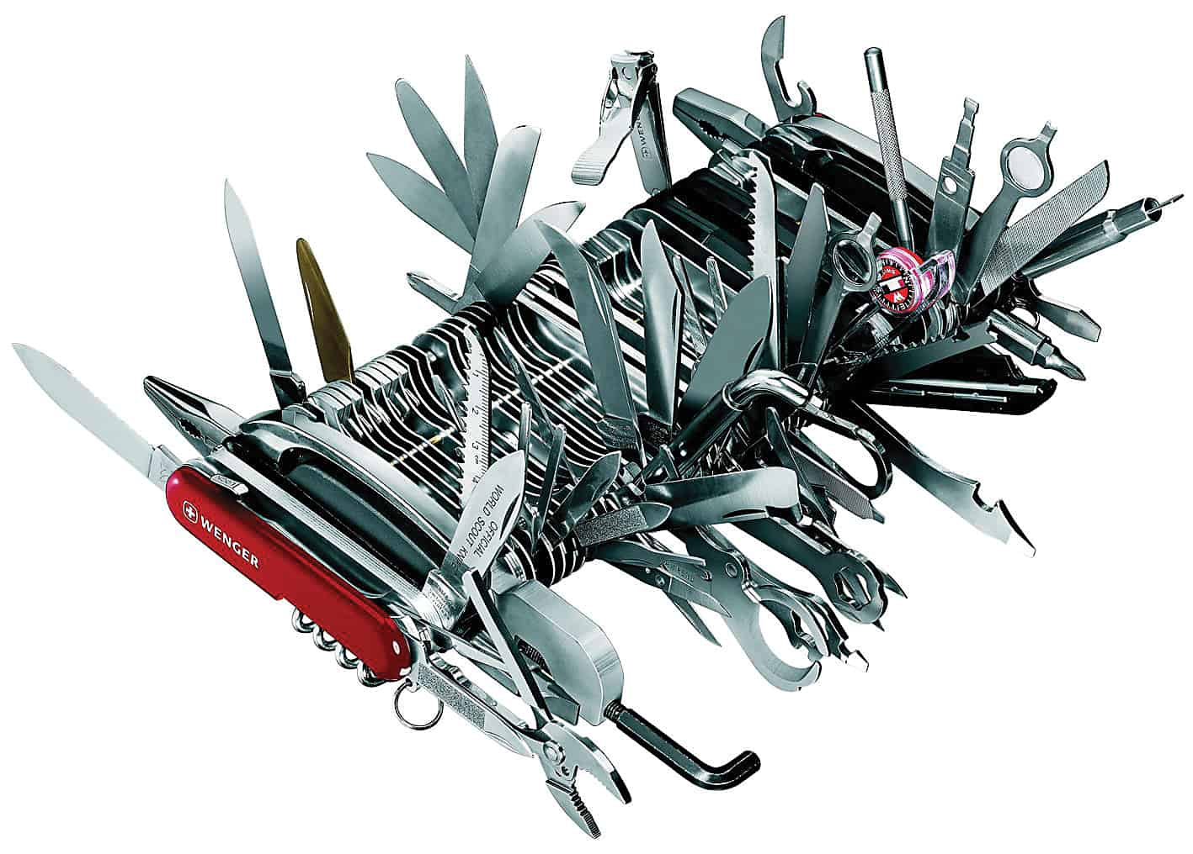
What can I do with Python and AWS?
Automate bulk creation of instances
Take snapshot backups of volumes
Trigger serverless functions
Retrieve cloud resource inventory
Bulk tag resources
Copy files to cloud storage or between cloud storage buckets
Apply configuration settings across batches of cloud resources
Amaze people into giving you a raise
8.268 Million more things . . .

Slide 8
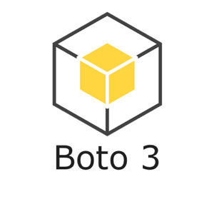
How do I get started with Python and AWS?
pip install boto3
Setup Credentials

Slide 9
SIMPLE BOTO3 EXAMPLE
import boto3
client = boto3.client(‘ec2’)
response = client.describe_instances(
InstanceIds=[‘i-123456789’]
)
print(response)

Slide 10
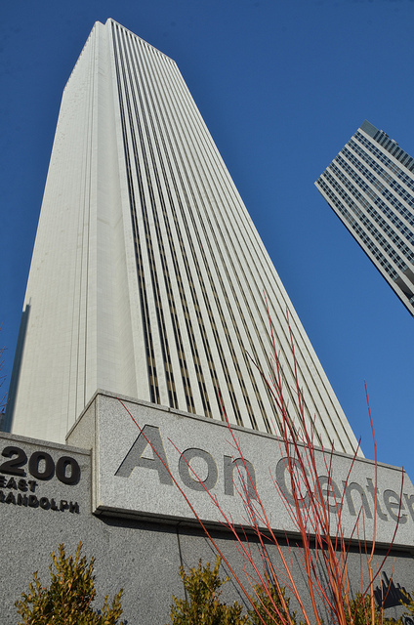
Real Life at FHLBC
NIMBUS
Serverless application that spins up copies of compute instances from one region in another using snapshots
Preserves original instance attributes
Takes minutes to spin up a clone in a different part of the world
Disaster recovery testing
SERVERLESS????
Not really
No servers to manage
Lambda

Slide 11
QUESTIONS?

Slide 12



THANK YOU!
SETH CARPENTER
802-236-9833
seth.g.carpenter@gmail.com

